Slide 1
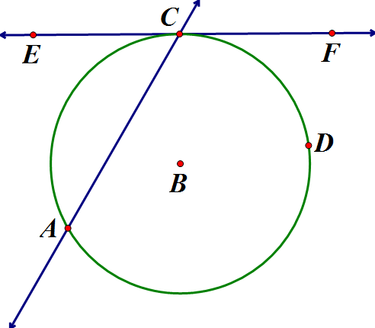
Look at the following tangent and secant in B:
What do you suppose the measure of is? How could we prove it?

Slide 2
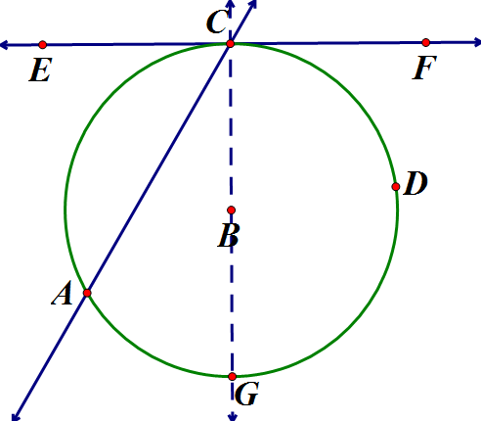
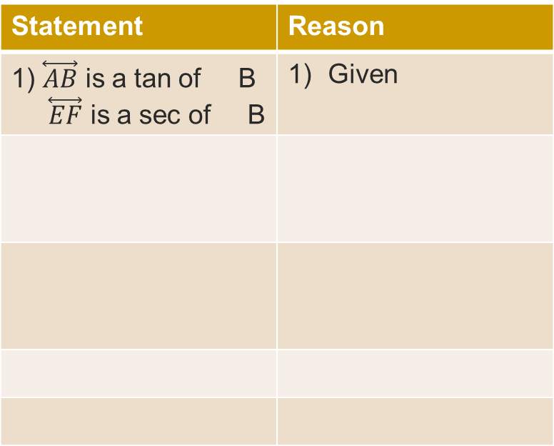
Look at the following tangent and secant in B:
Statement | Reason
1) $\overset{⃡}{AB}$ is a tan of B $\overset{⃡}{EF}$ is a sec of B | Given

Slide 3
So that’s a theorem!
  If a secant and a tangent intersect at the point of tangency, then the measure of each angle formed is one-half the measure of its intercepted arc.
  Draw a picture of what you think that means!

Slide 4
Another theorem:
  If two secants intersect in the interior of a circle, then the measure of an angle formed is one-half the sum of the measures of the arcs intercepted by the angle and its vertical angle.
  Draw it!

Slide 5
This theorem is wordy, so take a moment to think about it before writing it out:
  If two secants, a secant and a tangent, or two tangents intersect in the exterior of a circle, then the measure of the angle formed is one-half the positive difference of the measures of the intercepted arcs.

Slide 6
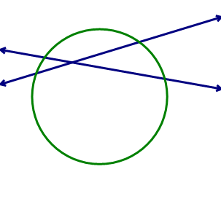



Examples
  Find the value of x.
85$°$
x$°$
2$30°$

Slide 7
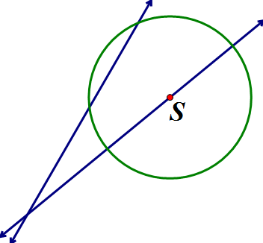



Examples
  Find the value of x.
$$84°$$
$$52°$$
x$°$

